Slide 1
File System

Slide 2
1. First of all if we talk about OS out of all the major functionality of an OS File system is the most important system.
2. We say that OS manages file but inside the code of OS we get a module, File System.
3. File system manages all of the files
(a)if we talk about windows it has NTFS file system. (Earlier DOS was there which has FAT file system)
(b) UNIX has UNIX file system.
(c ) LINUX has extended file system.
4. Means for every OS, in the code of OS in kernel you will find one module i.e. file system.
File System (Introduction)

Slide 3
File System (Introduction)
Whether a file system is a hardware or software ?

Slide 4
File System (Introduction)
If it’s a software. What does it do?

Slide 5
File System (Introduction)
It basically manages the file.
Means how the data will be stored and how the data will be fetched.
It manages data of users in the form of files.

Slide 6
File System (Introduction)
Lets take an example of a user:
How do we manage data > we manage it in the form of files
We copy any data from pen-drive in the form of file.
What we download is in the form of a file.
If we are sending an email , we may also attach files if required.
We send a file on whatsapp.
On daily basis we are dealing with files

Slide 7
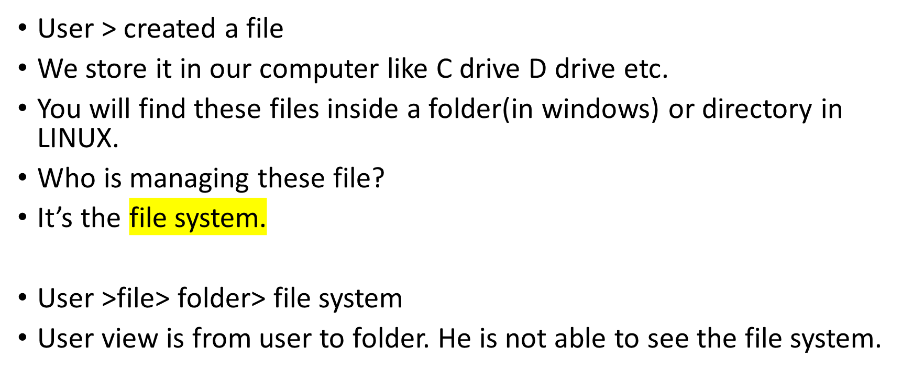
File System (Introduction)

Slide 8
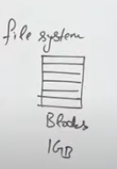
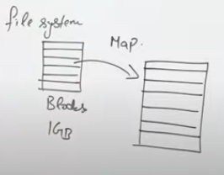
How the files stored inside the file system
It divides these files logically into blocks lets say a 1 GB file .
So we divided it into small parts or blocks.
Now we mapped those blocks with disk. We map with those sectors inside the disk

Slide 9
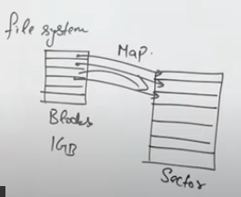
How the files stored inside the file system
Contiguous is not always possible since there may be some data in some blocks already.
Lets if I have ten rooms, and five students like s1, s2, s3, s4 and s5. Lets say some rooms are already booked say R1, R3, R4 and R8. Then we can assign these students to any empty rooms as per availability. Its similar to what we do in storing data inside blocks in a file system

